Slide 1
Meeting with Oksana
30/04

Slide 2
Completed Tasks

Slide 3
Dataset Creation
Generated the event videos for different accumulation times:
0,5 ms
1 ms
2 ms
5 ms
10 ms
Solved plenty of bugs with video (from python simulator) encoding. Solution was:
I was multiplying by 255 one time more than I should within the dataset class.
I was generating videos with too many fps, which leads to encoder instability
I was using mp4, which encodes the video based on key frames and relative frames. This led to some frames being corrupted. Changing to .avi with encoder MJPG solved this, as it stores all the frames.

Slide 4
Implementation with the model
Created the class for working with these videos in the training pipeline
Its actually very slow, so Ill try to store the frames independently instead of the videos to see if it gets better
Implementation in the training loop
I had to rethink how I was treating the labels and output of the model. Now all the functions are independent of the amount of variables that are being extracted from the model (previously I was extracting X,Y and now X,Y,R)

Slide 5
Problems with Cuda
Cuda was consistently running out of memory, as trajectories are much larger due to the accumulation time.
I am dividing the videos into chunks before feeding them into the model

Slide 6
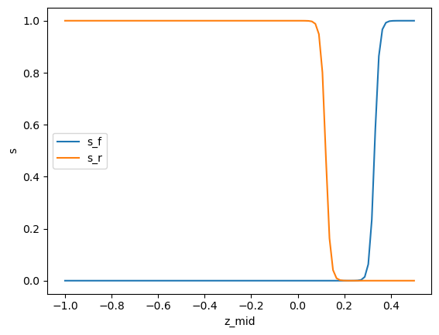
PISNN
I had an idea for the flight to roll regime integration in the loss function.
Computing a loss for each regime and weighting them by a sigmoid that depends on the predicted z
Leave a region in between regimes in which the model just relies on data loss

Slide 7
Ongoing and Proposed Future Tasks

Slide 8
Ongoing Tasks
Make the evaluation functions independent from the amount of predicted variables

Slide 9
Proposed Future Tasks
Finish the implementation of the evaluation
Make a dataset with just the frames and check whether it is faster
Find the optimal accumulation time, training-inference is class-weighted_avg, quant 4, explore num steps

